Slide 1
VIRTUAL DESKTOP ASSISTANT
Guided by :DR.Jyoti Deshmukh
Group no:06
SR.NO | NAME | ROLL NO
1. | CHATURDHAN CHAUBEY | 303
2. | MAHESH GAIKWAD | 309
3. | VISHAL GAWALI | 310
4. | ANJALI GUPTA | 323

Slide 2
Problem statement :
To reduce The problem faced is that library users require an efficient method to find a specific book or keyword(s) within a book given a continuously expanding library. Efficiency requires that the processing time should stay relatively the same even as the library contents increases.

Slide 3
ABSTRACT :
The library management system acts as a tool to transform traditional libraries into digital libraries .the student /user has to search for books which are hassle process and there is no proper maintenance of database about issues/fines.

Slide 4
INTRODUCTION :
AT A GLANCE :

Slide 5
2 . AT A GENRAL :
A task is a personal or related task that you want to pursue until you complete it Frequent tasks are added one at a time to the task list. When you mark one activity event completed, the next event appears in the List.
Here are some of the basic chores that can be accomplished with the help of a virtual assistant:
Conducting an online search, reading Wikipedia or Create a website.
Applications that are open , or send electronic mail and with (VAs)also play music from a folder on your computer and any other devices.
Listen to music via YouTube, Obtain the current date and time.
sdfdf

Slide 6
LITERATURE REVIEWS AND SUREY:
Each developer of a smart assistant company uses specific methods and techniques to improve the system, in a sequence that influences the system. One facilitator can combine the sentences correctly, another can add freely and without additional explanations and guidelines to perform tasks, and others can respond, but want to respond. Of course, no universal helper can do all the work in the same way. The set of qualities the assistant relies entirely on is where the developer has placed the most attention.

Slide 7
AUTHOR | YEAR | TOPIC | OBJECTIEVE | RESEARCH GROUP | RESULT
DR. Vivek Vishal Singh | 2022 | Virtual Desktop Assistance | The objective is to remove as much hardware as possible With the ingenuity of the VA present in the clouds, being pulled in, and pushing its way into our lives with many devices in our bodies and our offices, homes, and cars. Your VA will always tell you about suggestions and take orders, and you will know more about yourself than you know yourself. We can expect this device to be installed and permanent. | we are trying to not only stick on English language for Assistance. we are trying to come up with regional and local languages forassistance to remove the barrier of english language | Virtual Personal Assistants are a very effective way to organize your program. There are now many Smart Personal Digital Assistant apps available on the market for various device platforms. These new Software apps work much better than PDA devices as they provide all the features of your smartphone.

Slide 8
SYSTEM INFORMETION :
INTERNET APPLICATION :
VPA allows employees to access, customize, and use the Internet to help them access information from the weather, directions, and schedules, to stock performance, competitive data, and news.
The existing system’s understanding has to be greatly improved. Virtual assistants using Artificial Intelligence, such as Machine Learning, Neural Networks, python and IoT, will be the future of these helpers. By adopting this technology, we will be able to achieve new heights. Virtual assistants have the potential to achieve far more than you requirement .

Slide 9
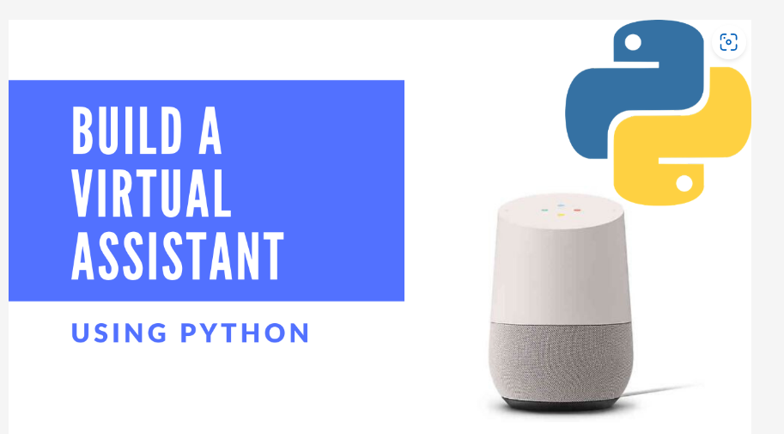
2.PYTHON LANGUAGE:
Python offers a good major library so that we can use it for making a virtual assistant. Windows has Sapi5 and Linux has Speak which can help us in having the voice from our machine.
JN

Slide 10
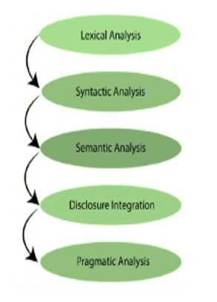
Working Principles:
SYSTEM ARCHITECTURE /BLOCK DIAGRAM :
The working of a Virtual Assistant uses the following principles:
Natural Language Processing: Natural Language Processing (NLP) refers to an AI approach to intelligent programming using a natural language such as English.
Five steps involved in Natural Language Processing (NLP) are:

Slide 11
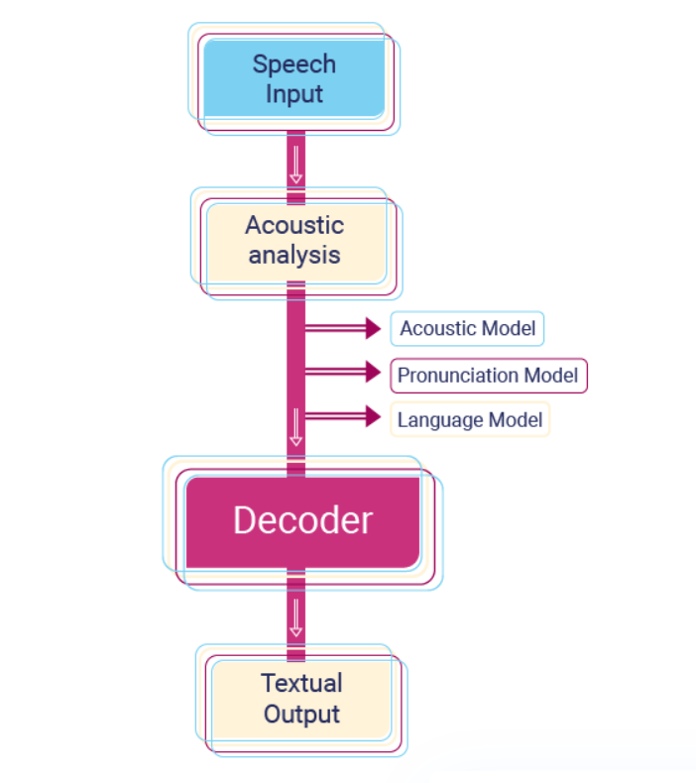
2. Automatic Speech Recognition:
To understand commands according to the user’s input.

Slide 12
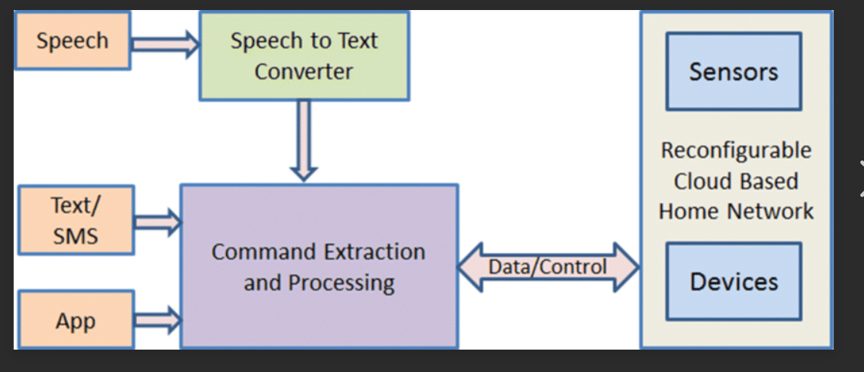
3.BLOCK DIAGRAM :

Slide 13
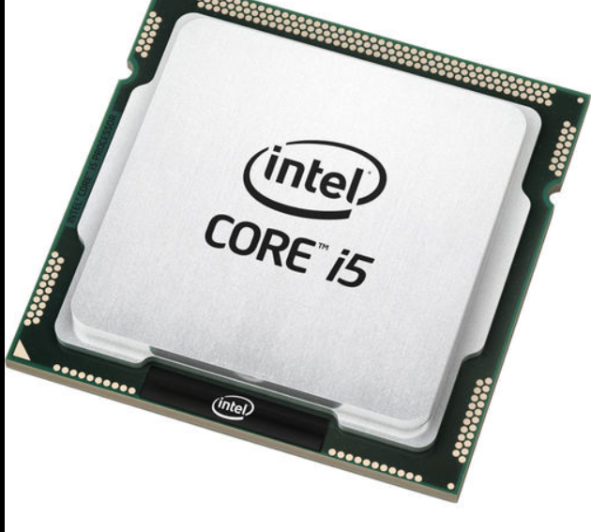
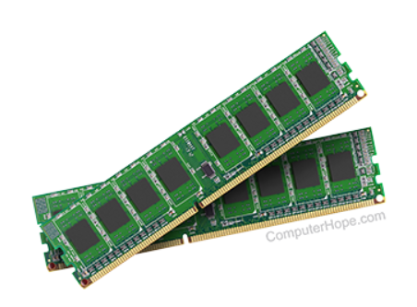
4.HARDWARE OF SYSTEM:
PROCESSOR : intel i5/i3 3rd generation or AMD A6
RAM: 8GB OR MORE.
SYSTEM : Computer or laptop.

Slide 14

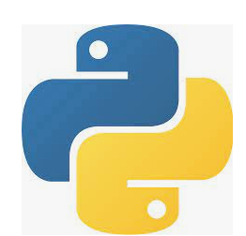
5.SOFTWARE OF SYSTEM:
Operating system should be WINDOWS 10 or higher.
Must have python installed.

Slide 15
METHODOLOGY:
TECHNIQUES/METHODS:
Considering overall research the voice application will be using mainly for three ways.
1.Firstly it provides command to the computers.
2. Secondly to input information to the computer.
3.Finally its communication with the people and voice- application can be divide into parts end interface

Slide 16
The data is collected in the form of speech and stored as an input for the next phase processing and input voice is continuously processed to converted to text using STT. 3] At the end of text to speech refers the ability of computers to read text aloud and converts written text to a phonemic representation and TTS engine with dialects and specialized vocabularies are available through the third party.
In simulation results it will be demonstrated that our proposed PARI various branches of the services to voice recognition engine which has an ability to work without internet connection and offline voice recognition

Slide 17
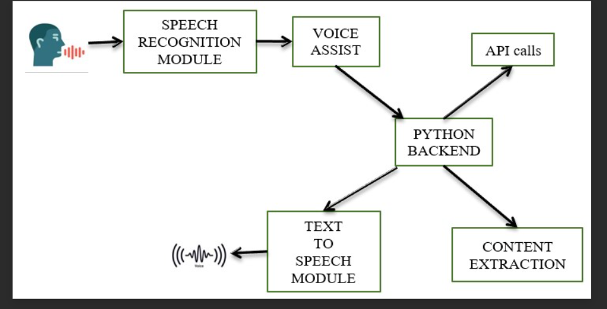
2.ALGORITHMS/FLOWCHARTS:
Step 1: Install the relevant modules and libraries
Step 2: Import the modules and libraries
Step 3: The “Assistant” function/pytsx3
Step 4: The Greeting function
Step 5: The Audio input/accepting verbal commands function

Slide 18
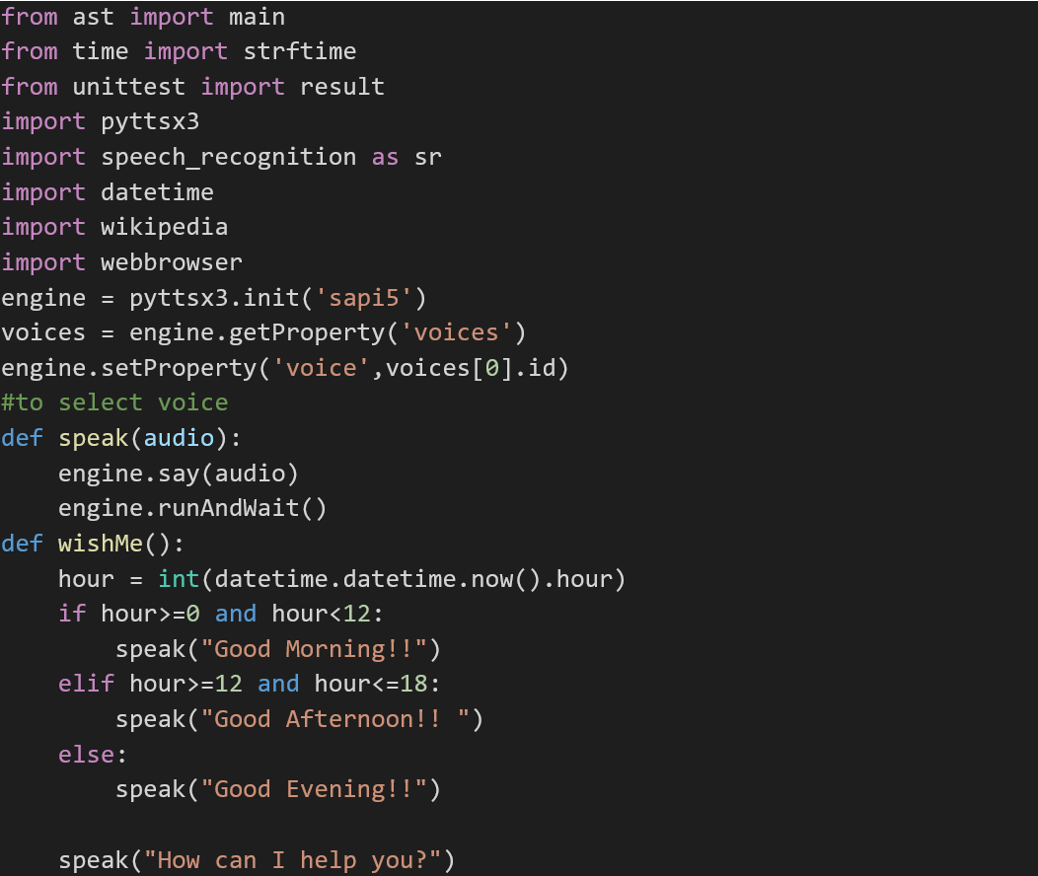
SOURCE CODE:

Slide 19
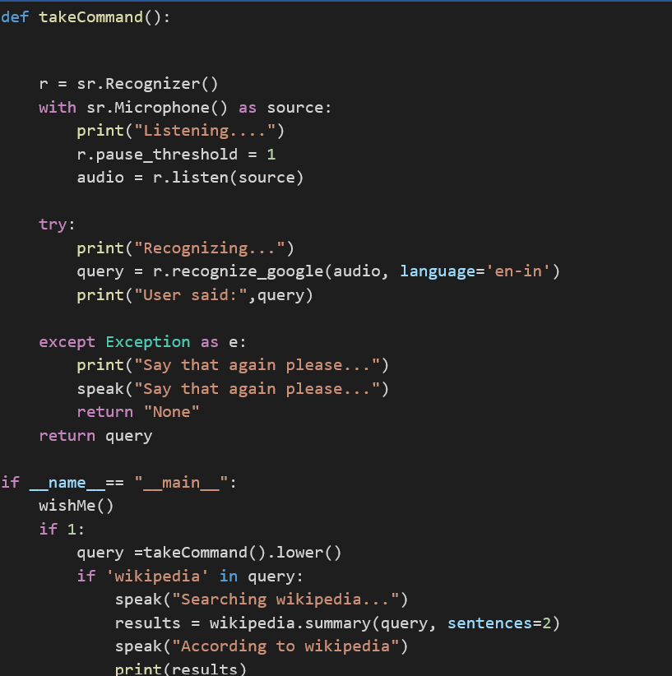

Slide 20
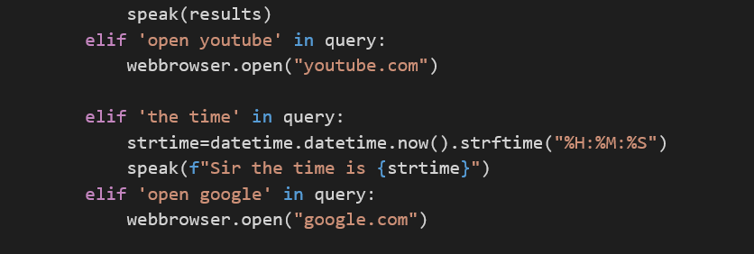

Slide 21
FUTURE SCOPE:
The next step will be to remove as much hardware as possible. With the ingenuity of the VA present in the clouds, being pulled in, and pushing its way into our lives with many devices in our bodies and our offices, homes, and cars. We can expect this device to be installed and permanent.
The voice technology at unprecedented levels and business must remain up to competition or risk missing out. And the consumers are embracing voice technology.

Slide 22
CONCLUSION:
Virtual Personal Assistants are a very effective way to organize your program. VPAs are also more reliable than Personal Assistants because VPAs are portable and you can use them at any time. And they have more information than any assistant as they are connected to the internet.
The main aim of this project study was to review and analyzes real-world voice technology application to spot their attainable security and accuracy and this devices solve the real world problem.
The devices can also be designed to interact with the other intelligent voice-controlled devices.

Slide 23
REFERNCES:
Websites referred
www.stackoverflow.com www.pythonprogramming.net www.tutorialspoint.com
YouTube channels
Codewithharry
CS dojo
Edureka!

Slide 24
😃Thank you.🤗

